Slide 1



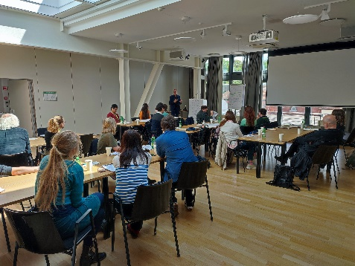
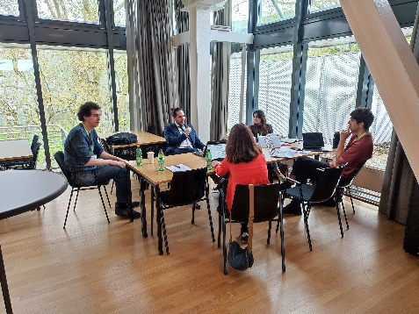
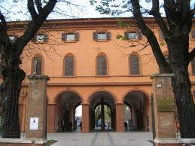
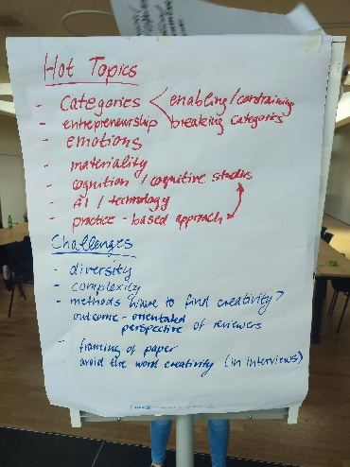
2Nd Transalpine
Organizing Creativity
Paper Development Workshop
May 27-28 2024
@ Reggio Emilia, Italy
Organized by Fabrizio Montanari, Elke Schüßler, Claudio Biscaro
More info at creativity@jku.at

